Slide 1

worktray
Platform for Business Solutions
Shirak Avakian

Slide 2

OVERVIEW
Quick Video Clip
Our Vision
Technology
My Experience

Slide 3

A Quick Look at Worktray
Notes:
Our Goal
Worktray has one unified goal, to create an environment where customers receive the best possible service, selection and value.
Our Mission
Our mission is to provide integrated and seamless business solutions for clients and participates under one platform.

Slide 4










OUR HUMAN CAPITAL MANAGEMENT SUITE
Compensation
Performance
Time & Attendance
Benefits
Scheduling
HR
Leave
Recruiting
Payroll
Notes:
Our Goal
Worktray has one unified goal, to create an environment where customers receive the best possible service, selection and value.
Our Mission
Our mission is to provide integrated and seamless business solutions for clients and participates under one platform.

Slide 5










THE FUTURE OF WORKTRAY
Buy/Sell
Loans
Accounting/Tax
IT
Software
Payroll
HR
Benefits
Scheduling
Leave
Performance
Recruiting
Compensation
Timekeeping
Notes:
Our Goal
Worktray has one unified goal, to create an environment where customers receive the best possible service, selection and value.
Our Mission
Our mission is to provide integrated and seamless business solutions for clients and participates under one platform.

Slide 6
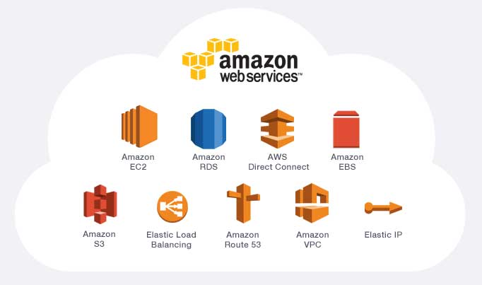



Technology
1- AWS Cloud hosting
2- Application server
3- IIS Web Server

Slide 7






Technology
Front Line Arsenal
Middle Tier Arsenal
Back End Arsenal
3rd Party API
Worktray API Manager
Worktray API

Slide 8

My Experience
Investors Perspective
Management Perspective
Developers / Community
Adobe

Slide 9
Thank You
Shirak Avakian
Director/Chief Solution Architect
Shirak.Avakian@worktray.com

